Slide 1
APRS Demo
EDCARC March 2021

Slide 2
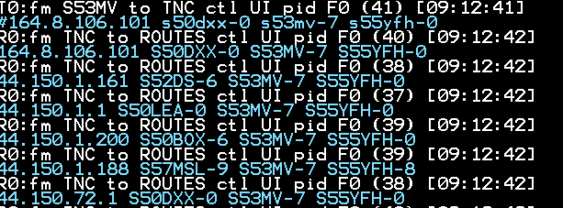
What is APRS?
APRS is short for Automatic Packet Reporting System – an amateur radio communications system for relaying real-time digital information that can be received locally and is also ingested into the APRS Internet System (APRS-IS), which is distributed globally for immediate access.
The system is based on the AX25 Packet protocol, and was developed by Bob Bruninga WB4APR, a senior research engineer at the United States Naval Academy.

Slide 3
What is Packet Radio
Packet radio is a digital radio communications mode used to send packets of data. Packet radio uses packet switching to transmit datagrams. This is very similar to how packets of data are transferred between nodes on the Internet. Packet radio can be used to transmit data long distances.
Packet radio is frequently used by amateur radio operators. The AX.25 (Amateur X.25) protocol was derived from the X.25 data link layer protocol and adapted for amateur radio use. Every AX.25 packet includes the sender's amateur radio callsign, which satisfies the US FCC requirements for amateur radio station identification. AX.25 allows other stations to automatically repeat packets to extend the range of transmissions. It is possible for any packet station to act as a digipeater, linking distant stations with each other through ad hoc networks. This makes packet radio especially useful for emergency communications.

Slide 4
Digipeating

Slide 5
A packet
GTOWN>APDW15,K6FGA-1*,WIDE2:!G:kP6/w-`#{<G KM6LYW fillin digi. In Service. RF and Internet online.
W6ZZY-2>APN383,ALDER,K6FGA-1*,WIDE2:@091521z3847.27N/12009.90W_000/000g003t036r000p000P000h81b10178.DsVP
N8QH-9>APOT30,WA6TOW-2,WIDE1,K6FGA-1*,WIDE2:$ULTW00000000025D000027CB0007863400010000004C020D00000000
N8QH-9>APOT30,WA6TOW-2,WIDE1,BKELEY,WIDE2*:$ULTW00000000025D000027CB0007863400010000004C020D00000000
KD2LRL-9>3W4URT,K7FED-1*,WIDE2-1:`16$m>_j/]"3r}146.520MHz GXOR CA=

Slide 6
Where is APRS/Packet located
Can be used on about any Amateur Radio band with digital sub-band
APRS is most commonly on 2m 144.390 in North America
APRS is also digipeated via some satellites but on different frequencies.
Packet also exists on 2m for Winlink, Packet keyboard to keyboard and BBS

Slide 7
What is APRS used for?
Position reporting
Special events races
ARES
Balloon and rockets
Messaging
Weather Reporting
Telemetry (Repeater status)

Slide 8
APRS Equipment
Computer
GPRS
Transceiver
TNC
Smart Phone ?

Slide 9
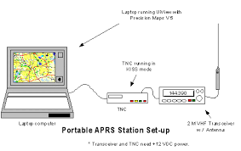
APRS Equipment

Slide 10
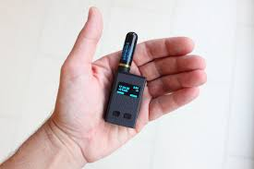
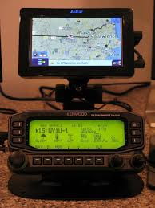
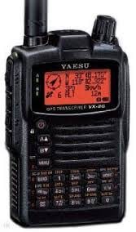
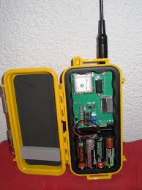
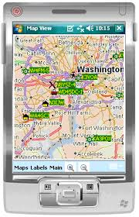
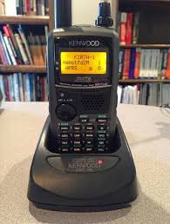
APRS Equipment

Slide 11
Using APRS
Assemble or buy APRS Station
Internet https://aprs.fi
Andriod phone/tablet APRSDroid application

Slide 12
APRS Demo
https://aprs.fi
PinPoint APRS
APRSDroid

Slide 13
APRS References
https://aprs.fi
http://joplin-arc.org/jarcwp/wp-content/uploads/2016/04/APRS-K0JAA-2016.pdf

